Slide 1
Mapping Defect location & Case Study

Slide 2
HBM Test methods
Chip_detection: Special circuitry surrounding DRAM edges to detect die crack or chipping.
Log output: showed SID # only
MBIST_March: Read Modified Write (RMW)
Test methodology: Read one and write zero to cells one by one
Log output: HBM#, SID#, Channel#, Psudo channel#, Bank#, 16 memory Row addresses to repair
MBIST_scan: Memory bit reflash time test
Test methodology: Read memory cells with time interval (ex. 32ms) without leakage compensation.
Log output: HBM#, SID#, Channel#, Psudo channel#, Bank#, 16 memory Row addresses to repair
CDC Circuitry

Slide 3
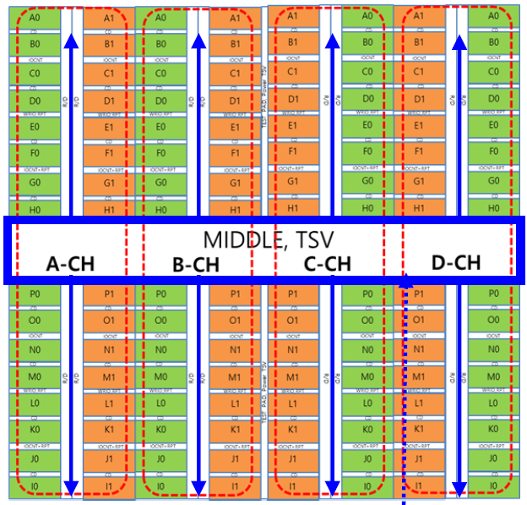
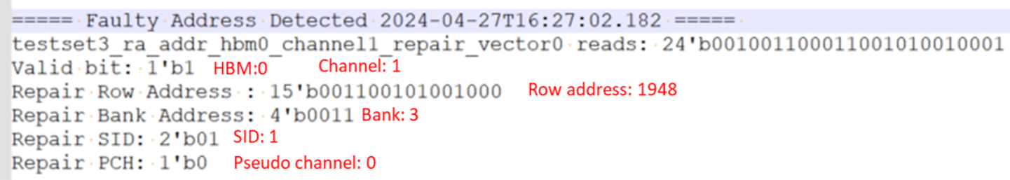
HBM Test sequence & test log information
March and Scan test running by Channel and Bank order
One channel has 32banks and one bank has 1024 row addresses
Max. 16 addresses are repairable per channel.
Only 16 addresses are logged per channel as well.

Slide 4
HBM defect prediction with test logs
Clues for prediction
Is there CDC failed?
Basic factor to determine die edge crack existence.
Not every die edge crack showed CDC failure.
Where is the failed bank located?
Edge located banks have higher risk of crack
Failed at March or Scan test? or failed both?
Memory cell defect or control circuit defect
Which bank showed 16 failing addresses?
The banks tested after the failing bank are possibly failed as well.
Failing address count is 16 or less?
What are the failing addresses?
The bank is partially or fully dead & functional.

Slide 5
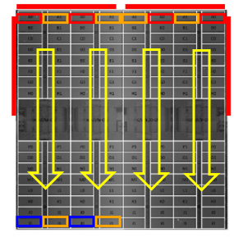
HBM Failure Case Study _ Silicon inner circuitry damage
Is there CDC failed? No
Possibly not crack related
Where is the failed bank located?
All A0 banks of each channel at the die top edge
Failed at March or Scan test? or failed both?
Failed both, the banks are fully dead
CH
I
CH
J
CH
K
CH
L
Which bank showed 16 failing addresses?
All fail banks have 16 addresses.
Rest of 15 banks B,C,..H&P are possibly failed as well
Failing address count is 16 or less?
What are the failing addresses?
16 addresses failed and they are continuous.
The banks are fully dead.
HBM | Core | Channel | Bank | Failed_Test | failed_address | failed_address_count | Fail_mode
G | 3 | I0 | A0 | March & Scan | [0x14, 0x12, 0x18, 0x8, 0x1c, 0x0, 0xa, 0x1e, 0xe, 0x16, 0x6, 0x1a, 0xc, 0x4, 0x10, 0x2] | 16 | Gross
G | 3 | J0 | A0 | March & Scan | [0x14, 0x12, 0x18, 0x8, 0x1c, 0x0, 0xa, 0x1e, 0xe, 0x16, 0x6, 0x1a, 0xc, 0x4, 0x10, 0x2] | 16 | Gross
G | 3 | K0 | A0 | March & Scan | [0x14, 0x12, 0x18, 0x8, 0x1c, 0x0, 0xa, 0x1e, 0xe, 0x16, 0x6, 0x1a, 0xc, 0x4, 0x10, 0x2] | 16 | Gross
G | 3 | L0 | A0 | March & Scan | [0x14, 0x12, 0x18, 0x8, 0x1c, 0x0, 0xa, 0x1e, 0xe, 0x16, 0x6, 0x1a, 0xc, 0x4, 0x10, 0x2] | 16 | Gross
Review Result
Entire banks are not working due to Power supply or defective control circuitry.
The banks or memory cells are not defective. Buffer die or memory controller problem.

Slide 6
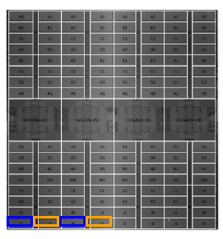
HBM Failure Case Study _ Lateral Crack
Is there CDC failed? No
PFA
Crack
Where is the failed bank located?
Bottom Corner, Bank I0 in Ch A & B
CH
A
CH
B
Failed at March or Scan test? or failed both?
Failed both, the banks are fully or partially dead
CDC
Which bank showed 16 failing addresses?
All fail banks have 16 addresses.
Rest of 15 banks J,K,L..P are possibly failed as well
Failing address count is 16 or less?
What are the failing addresses?
16 addresses failed and they are continuous.
The banks are fully dead.
Crack
: Possible crack location
HBM | Core | Channel | Bank | Failed_Test | failed_address | failed_address_count | Fail_mode
B | 7 | A0 | I0 | March & Scan | [0xa, 0x16, 0x6, 0x0, 0x1c, 0x12, 0x1e, 0xe, 0x2, 0x4, 0x18, 0x1a, 0xc, 0x8, 0x14, 0x10] | 16 | cell
B | 7 | B0 | I0 | March & Scan | [0xa, 0x16, 0x6, 0x0, 0x1c, 0x12, 0x1e, 0xe, 0x2, 0x4, 0x18, 0x1a, 0xc, 0x8, 0x14, 0x10] | 16 | cell
Review Result
Banks located bottom left corner are dead. (Banks A to H are functional.)
The banks located corner edge are defective. Possibly crack related

Slide 7
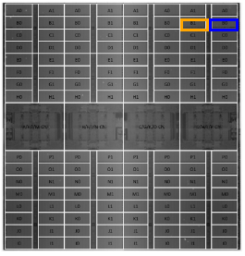
HBM Failure Case Study _ Vertical Crack
Is there CDC failed? No
PFA
Where is the failed bank located?
Top Corner, Bank B0 in Ch D
Crack
Failed at March or Scan test? or failed both?
Failed both, the banks are fully or partially dead
CH
H
Which bank showed 16 failing addresses?
All fail banks have 16 addresses.
Rest of 15 banks C,D,E..P are possibly failed as well
Failing address count is 16 or less?
What are the failing addresses?
16 addresses failed and they are continuous.
But the starting address is not 0X0, The banks are partially dead.
: Possible crack location
HBM | Core | Channel | Bank | Failed_Test | failed_address | failed_address_count | Fail_mode
D | 2 | H0 | B0 | March & Scan | [0x1414, 0x140a, 0x1412, 0x1416, 0x141a, 0x141c, 0x140e, 0x1418, 0x141e, 0x1410, 0x140c, 0x1406, 0x1408, 0x1404, 0x1400, 0x1402] | 16 | cell
Review Result
Banks located top left corner are partially dead.
Failed address is not starting from zero
The banks located corner edge are defective. Possibly crack related

Slide 8
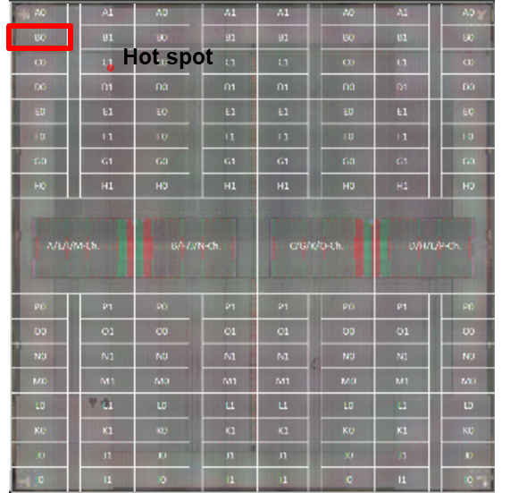
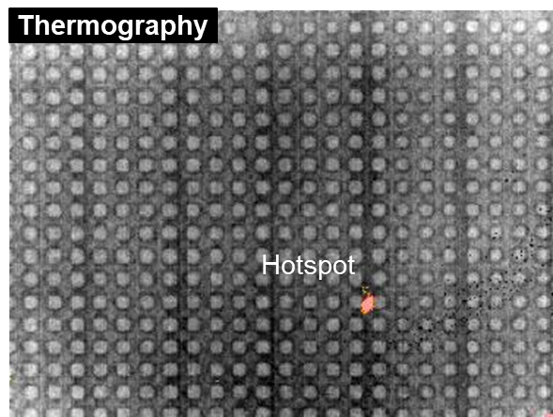
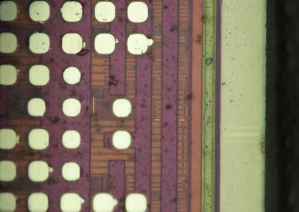
HBM Failure Case Study _ Silicon Internal Circuitry – Functional
Is there CDC failed? No
Where is the failed bank located?
Top Corner, Bank B0 in Ch A
Failed at March or Scan test? or failed both?
Failed both but failing addresses are different
The memory cells are some how functional.
Which bank showed 16 failing addresses?
All fail banks have 16 addresses.
Rest of 15 banks C,D,E..P are possibly failed as well
Failing address count is 16 or less?
What are the failing addresses?
16 addresses failed and addresses are random
HBM | Core | Channel | Bank |  | Address_failed | fail_addr_count
E | 9 | A0 | B0 | March | 0x1852,0x18b2,0x18c1,0x18d9,0x18ff,0x190a,0x1912,0x1914,0x1942,0x1952,0x1959,0x195f,0x1966,0x196c,0x1971,0x197c | 16
E | 9 | A0 | B0 | Scan | 0xb26,0x1857,0x1912,0x1942,0x19f9,0x1a29,0x1a66,0x1a85,0x1aa9,0x1aba,0x1ae0,0x1ae5,0x1aea,0x1b10,0x1b26,0x1b32 | 16
Review Result
Banks located top left corner are functional failure.
Memory cell functional failure. Memory address or bit level issue.
No obvious die edge discoloration/ crack was observed along right edge.

Slide 9
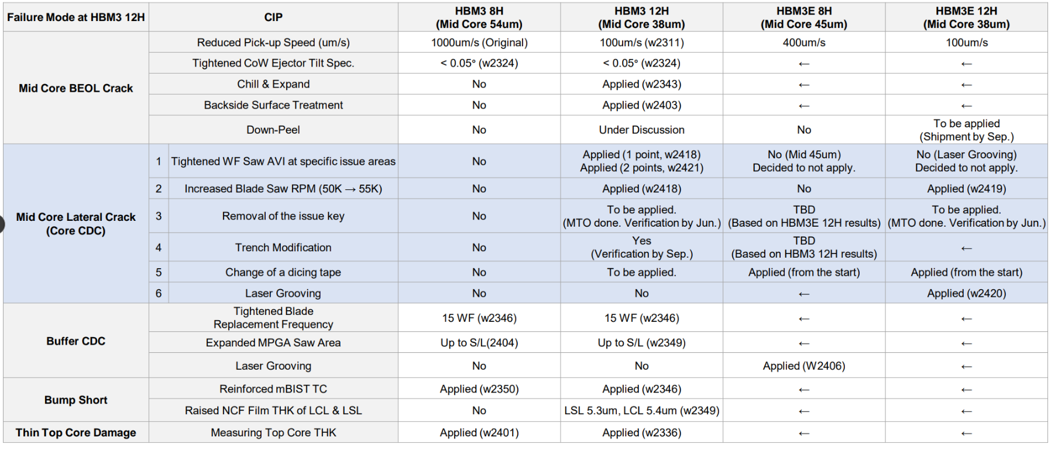
Actions taken to prevent gross damage

Slide 10
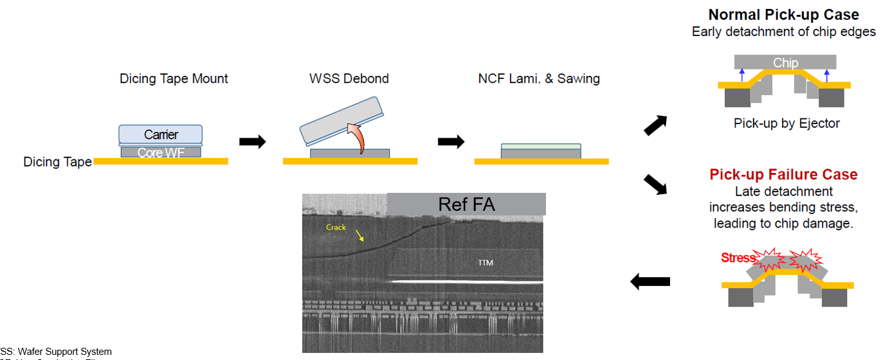
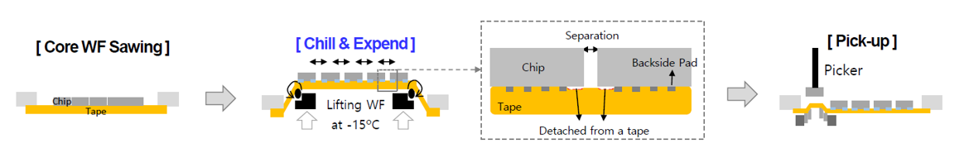
Failure mechanism – BEOL internal crack
Crack occur due to the adhesion of the dicing tape.
Ejector control parameter optimization: Speed and tilt
Chill & Expansion: Decrease adhesion of the dicing tape.

Slide 11
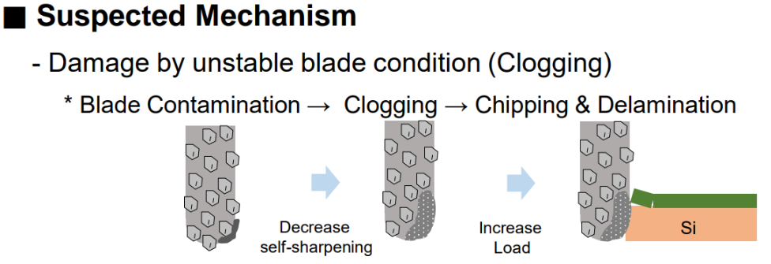

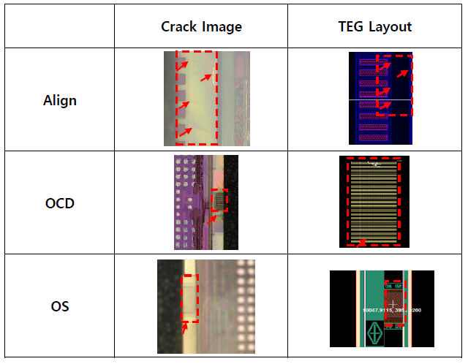
Failure mechanism – Lateral Crack
Lateral crack starts left and right-side edges
Because
special patterns are located along these saw lines
OCD: Optical Critical Dimension
OS: Oxide Site

Slide 12
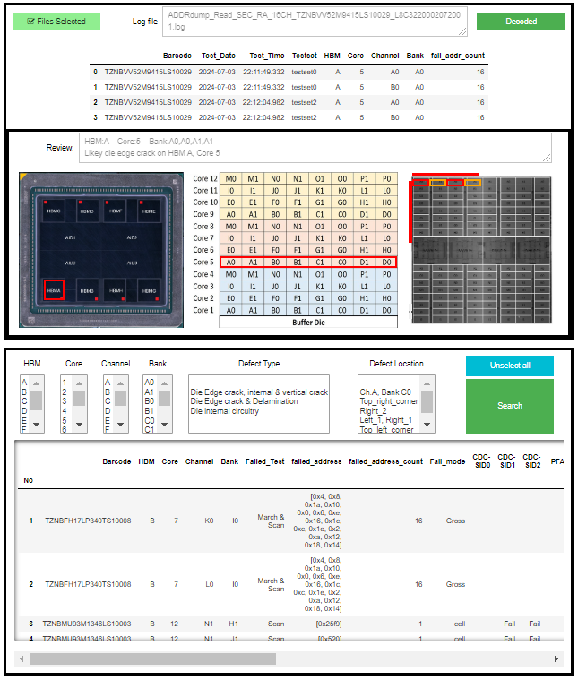
HBM Failure Library & Automated Defect Mapping Tool
Log summary
Log Review
Log review result & Defect Location mapping
Defect Mapping
Lib Filters
HBM Library
Tables

Slide 13
HBM test log review history with Automated Defect Mapping tool
HBM Temp Cycle DOE;
120 HBM failure are reviewed, and 3 cases were performed PFA.
3/3 Physical defects were found at the suspected location from the log review.
Production – NPI failure;
7 HBM failure cases were requested for log review
2 cases were performed PFA and found defect at one case.
SMR0167714 – FT failure;
3 HBM failures were requested for log review
2 of them were selected and being performed PFA @ SEC

